Slide 1


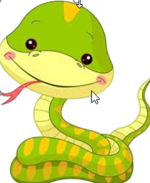
www.Shyamsir.com
78 74 39 11 91

Slide 2

Dictionary
Dictionaries are in curly brackets.
Key-value pairs are separated by commas and keys and values are separated by colons.
{key1:value1, key2:value2, key3:value3}

Slide 3

List – Each

Slide 4
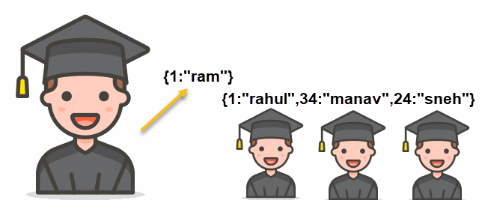
Dictionary

Slide 5
Dictionary #1
students={1:"Ram", 2:"Jayul", 3:"Rahul",4:"Anjali",5:"Riya"}
marks={1:22,2:33,3:16,4:39,5:45}
print(students)
print(marks)

Slide 6
Dictionary #2 Check if duplicate
marks={1:22,2:33,3:16,4:39,5:45,4:45, 4:55}
print(marks)

Slide 7
Dictionary #3
students={}
students[1]="Ram"
students[22]="Jayul"
students[3]="Rahul"
students[44]="Anjali"
print(students)

Slide 8
Dictionary #4
students={1:"Ram", 22:"Jayul", 3:"Rahul",44:"Anjali",50:"Riya"}
print(students[22])
print(students.get(44))

Slide 9
Dictionary #6
students={1:"Ram", 22:"Jayul", 3:"Rahul",44:"Anjali",50:"Riya",12:"Hiral",33:"Karan"}
for key,value in students.items():
print(key,value)

Slide 10
Dictionary #7
students={1:"Ram", 22:"Jayul", 3:"Rahul",44:"Anjali",50:"Riya",12:"Hiral",33:"Karan"}
for key in students:
print(key)

Slide 11
Dictionary #8
students={1:"Ram", 22:"Jayul", 3:"Rahul",44:"Anjali",50:"Riya",12:"Hiral",33:"Karan"}
for key in students:
print(students[key])

Slide 12
Dictionary #9
students={1:"Ram", 22:"Jayul", 3:"Rahul",44:"Anjali",50:"Riya",12:"Hiral",33:"Karan"}
for value in students.values():
print(value)

Slide 13
Dictionary #10
students={1:"Ram", 22:"Jayul", 3:"Rahul",44:"Anjali",50:"Riya",12:"Hiral",33:"Karan"}
keys = students.keys()
values = students.values()
print(keys)
print(values)

Slide 14
Dictionary #11
students={1:"Ram", 22:"Jayul", 3:"Rahul",44:"Anjali",50:"Riya",12:"Hiral",33:"Karan"}
students.pop(22)
print(students)
students.popitem()
print(students)
del students[44]
print(students)
students.clear()
print(students)

Slide 15
Exercise
students={11:"rahul",33:"manav",45:"mansi",70:"neha",36:"riya",5:"aadesh",7:"kiran",22:"dev",11:"param",17:"aadi",19:"diya"}

Slide 16
Dictionary #12 Delete
students={1:"Ram", 22:"Jayul", 3:"Rahul",44:"Anjali",50:"Riya",12:"Hiral",33:"Karan"}
students.pop(22)
print(students)
students.popitem()
print(students)
del students[44]
print(students)
students.clear()
print(students)

Slide 17
Dictionary #13 How to Add?
students={1:"Ram", 22:"Jayul", 3:"Rahul",44:"Anjali",50:"Riya"}
print(students)
students[33]="Hiral"
print(students)

Slide 18
Dictionary #13 How to Add?
students.setdefault(101,"Sita")
print(students)
students.setdefault(102,"")
students[102]="Ravan"
print(students)

Slide 19
Dictionary #14 How to Merge?
cubes={1: 1, 2: 8, 3: 27}
cubes1={4:64, 5:125}
cubes.update(cubes1)
print(cubes)

Slide 20
Exercise
Display Total
Display Pass / Fail
Display only Pass students
Display Pass/Fail along with count of pass and fail students
Enter no and display record
Enter name and display record
Give Choice 1 for pass ,2 for fail ,3 for both

Slide 21
Any Question?
www.Shyamsir.com
78 74 39 11 91

